Slide 1
Group 42 Face Recognition to Play music
0610032 林仲偉
0610032 彭楚鈞

Slide 2
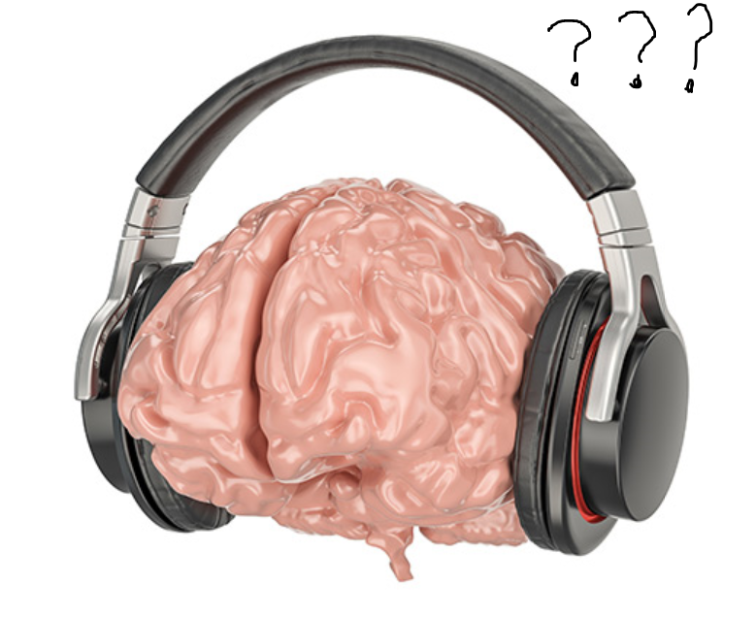
Inspiration
Have no idea to choose which song
Machine learning on Stm32 sounds cool
Objective
Snapshot the picture took from camera
Input the image and verify it by network
Play a song according to some feature (emotion, age, gender, hair, etc.)

Slide 3
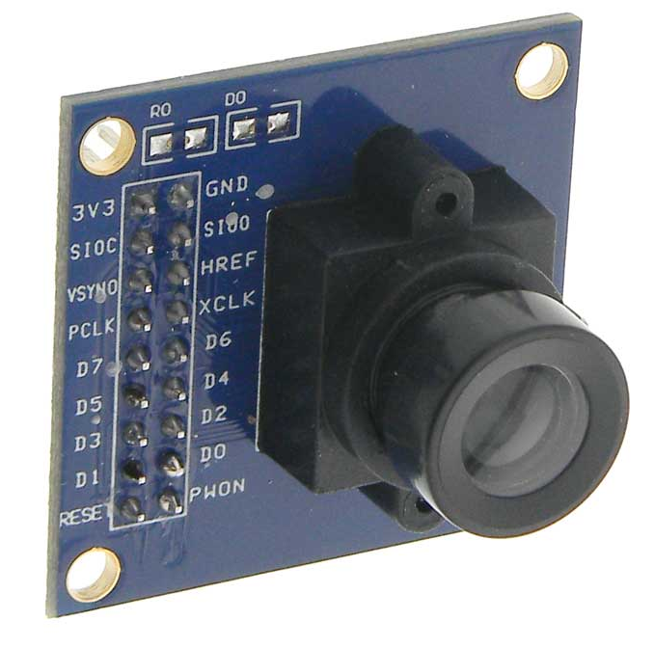
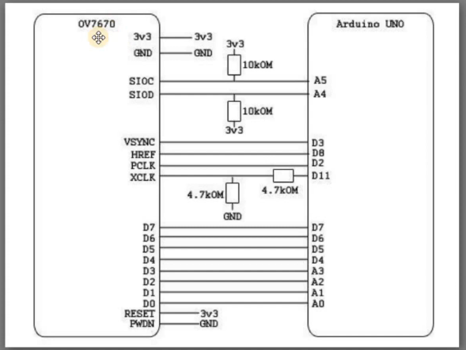
Requirement
Hardware
STM32L4-L476RG
OV7670: Camera (300$)
Software
Arduino
STM32CUBEMX
X-CUBE-AI
Pre-trained Neural Network
Support Keras, TensorFlow
User interface (Maybe)

Slide 4
Problem might encounter
How to load and pass image?
Where does the data come from?
How to train? Which model to use?
How many classes?
How to choose suitable song?

